Slide 1
Week 10: Term Project
Rajkumar Kuppuswami
DSC530-T302 Data Exploration and Analysis (2207-1)

Slide 2
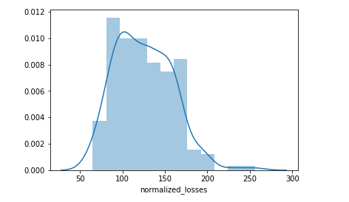
My Data source -Automobile
Automobile data source give more detail about the car details.
I have used normalized_losses for getting the Histogram trend.

Slide 3
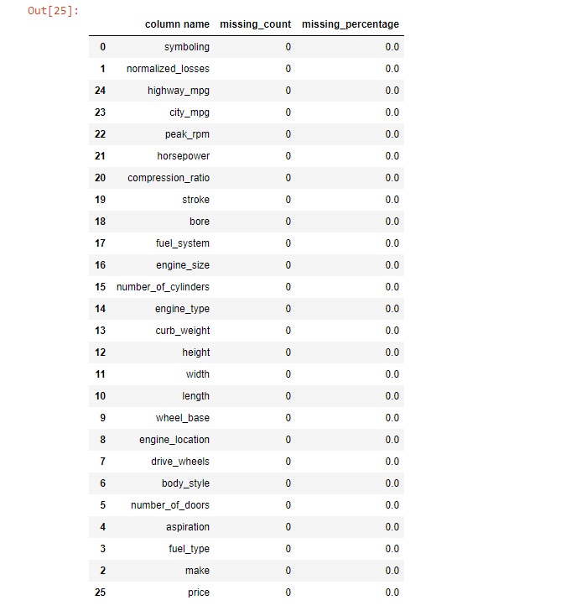
There are a few columns that are outliers in terms of the proportion of values that are missing. I will need to identify and document these columns. While some of these columns might have justifications for keeping or re-encoding the data. Besides, I will plot a histogram graph to better visualize the columns with missing data.
def assess_missing_data(df):
'''
A function to find out the missing data and its statistic information
input:
df: the data frame
output:
df_stats: the statistic information of missing column, will be missing value count and
missing value percentage
'''
rec = []
for column_name in df.columns:
miss_count = df[column_name].isnull().sum(axis=0)
miss_percent=miss_count/df.shape[0]
rec.append([column_name,miss_count,miss_percent*100])
df_stats = pd.DataFrame.from_records(rec, columns = ['column name',
'missing_count','missing_percentage'])
df_stats = df_stats.sort_values('missing_percentage',axis=0, ascending = False )
return df_stats
df_stats = assess_missing_data(df)
df_stats

Slide 4
Include the other descriptive characteristics about the variables: Mean, Mode, Spread, and Tails (Chapter 2).
import numpy as np
my_list = np.asarray([1, 2, 2, 2, 4, 5, 6, 6, 6, 9, 10, 10, 10, 11, 14, 14, 15, 18, 19, 20])
np.var(my_list)
np.std(my_list)
np.mean(my_list)
lower_range = 9.2 - 5.8
higher_range = 9.2 + 5.8
lower_range
higher_range

Slide 5
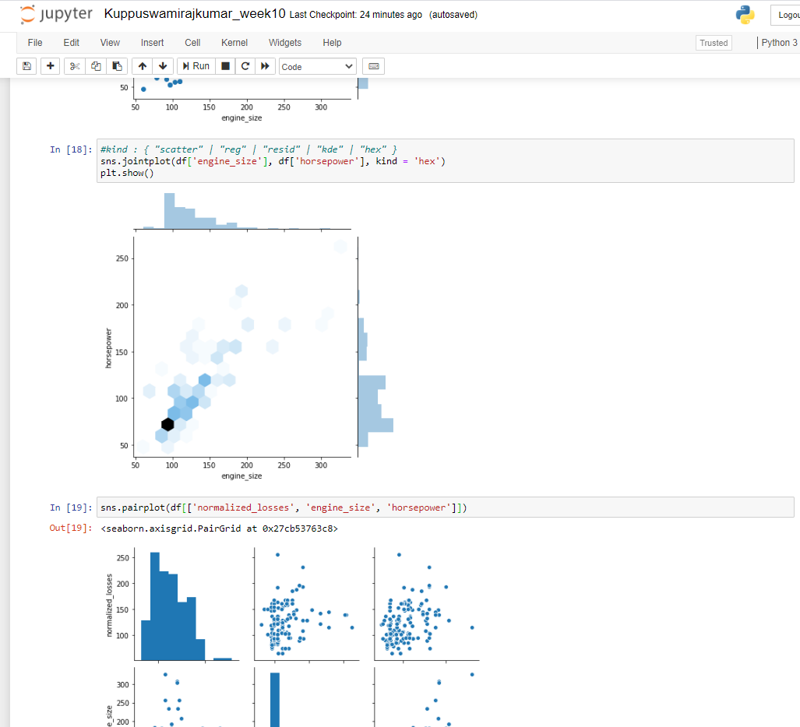
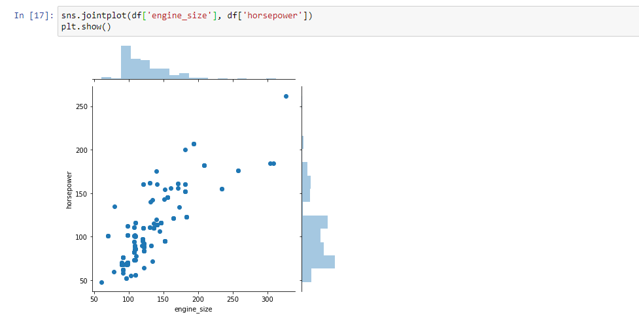
Create two scatter plots comparing two variables and provide your analysis on correlation and causation.

Slide 6
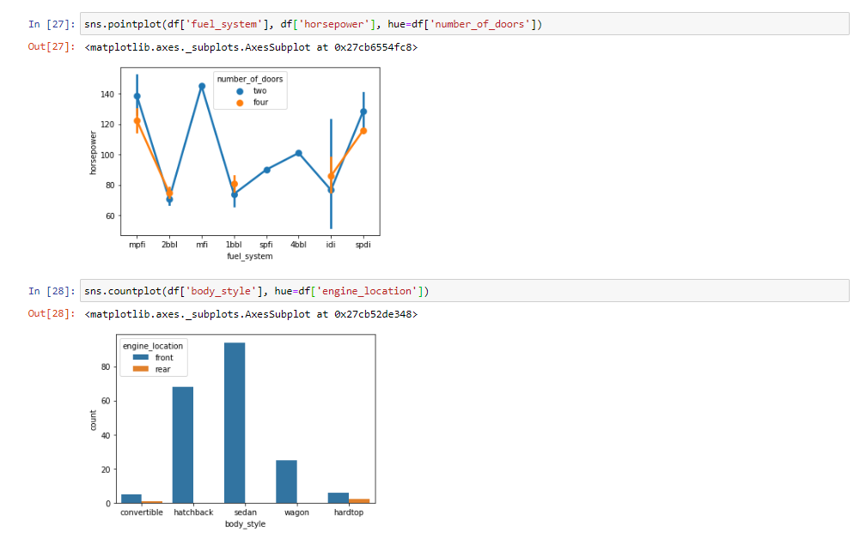
Plot 1 analytical distribution and provide your analysis on how it applies to the dataset you have chosen

Slide 7
Outcome of your EDA What do you feel was missed during the analysis? Were there any variables you felt could have helped in the analysis? Were there any assumptions made you felt were incorrect? What challenges did you face, what did you not fully understand?
Based on the data source I used it is limited to quantify the detail since the data source size is very small
Data was destroyed when a proprietary archive was being manually moved.
There had been an mistake in scripting.
People opted not to fill out a area that was related to their values on whether to use or perceive the outcomes.
A bit more complex and we'll have to work of a method to find the missing values of these kinds. There are a variety of possible strategies but this is the way I will work on this one. The entry can be changed into an integer, enter a missing value The number can’t be an integer, we know it’s a string
Misusing expressions as defaults for function arguments
A typical error is to assume that each time the feature is called the optional argument will be set to the specified default expression without providing a value for the optional argument.
Conclusion
Dealing with messy data is inevitable. Data cleaning is just part of the process on a data science project.

